Slide 1

MAZE GENERATOR
Name: Vy Phung, Trang Vu

Slide 2
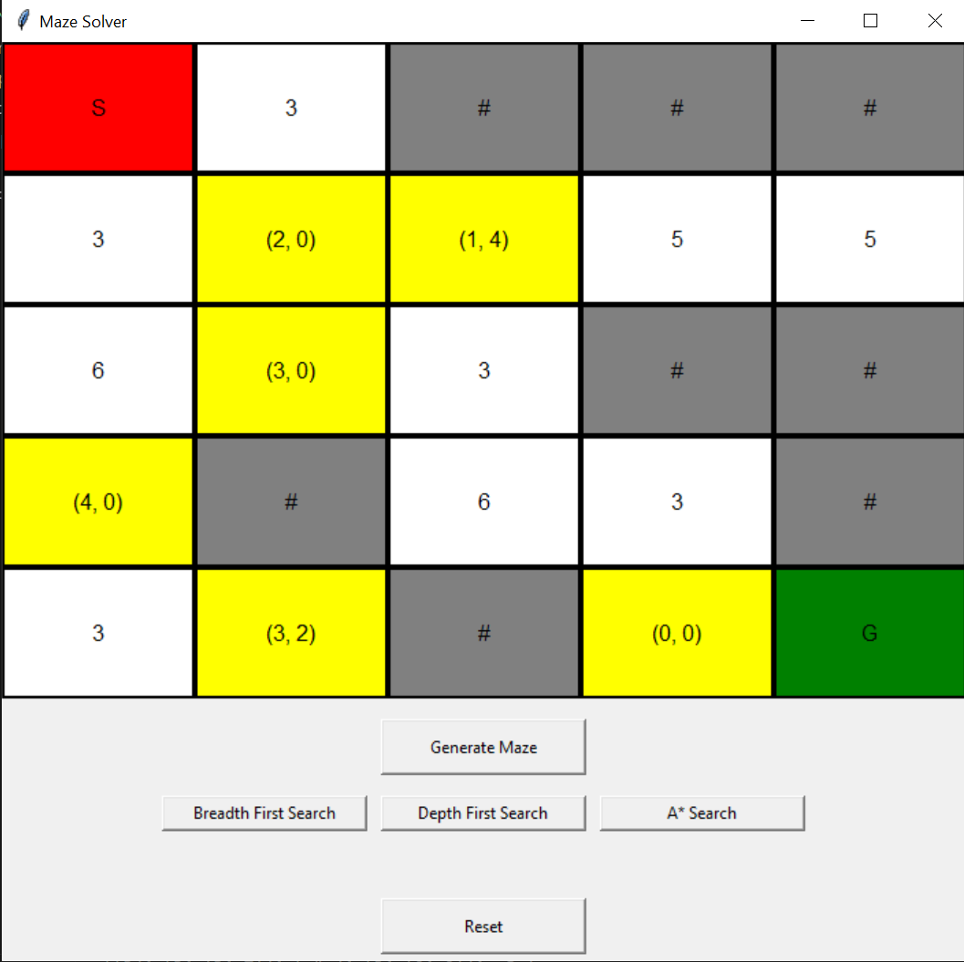
Introduce Maze
Starting point
Goal point
Teleporter
Walls
Cost

Slide 3
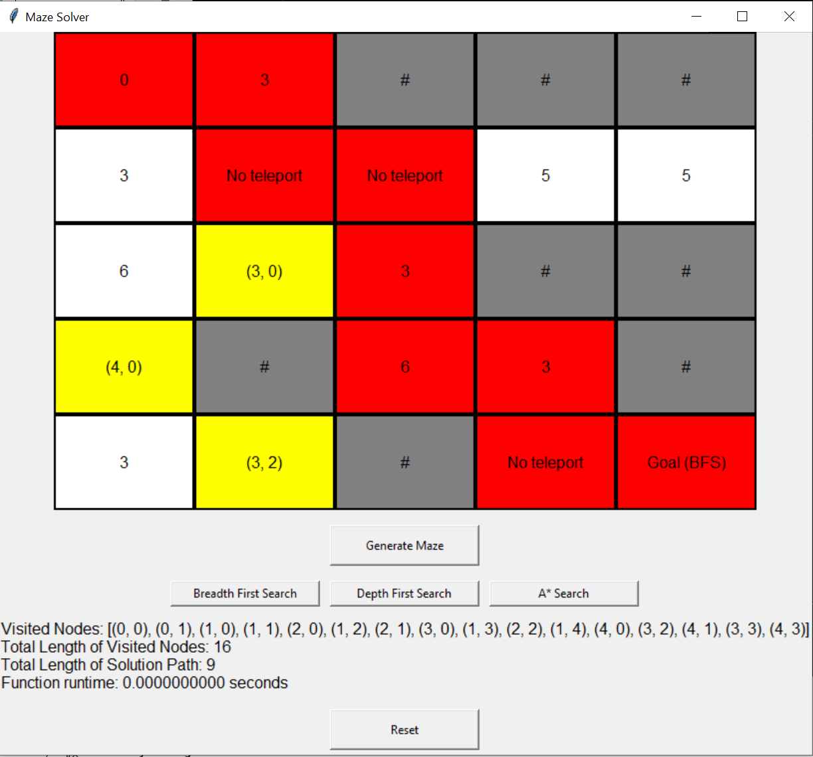
Breadth First Search

Slide 4
Demo time

Slide 5
Performance analysis
 | Breadth First Search | Depth First Search | A* Search
Solving Time
Path length
Explored Nodes
Cost path | - | -

Slide 6
Thank you for listening

